Slide 1
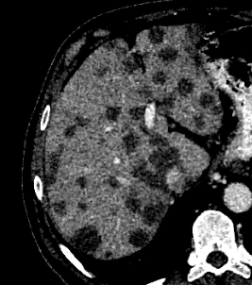
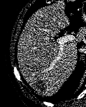
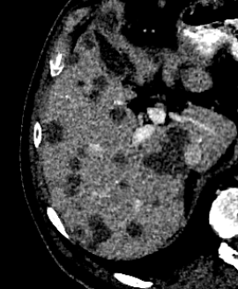

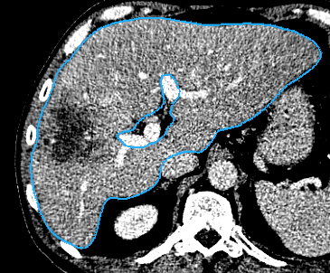
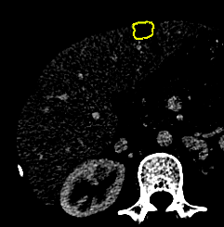


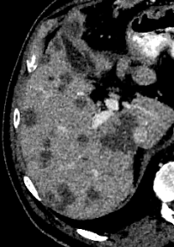
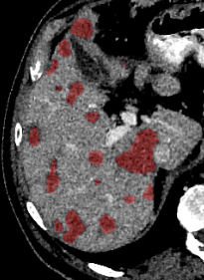


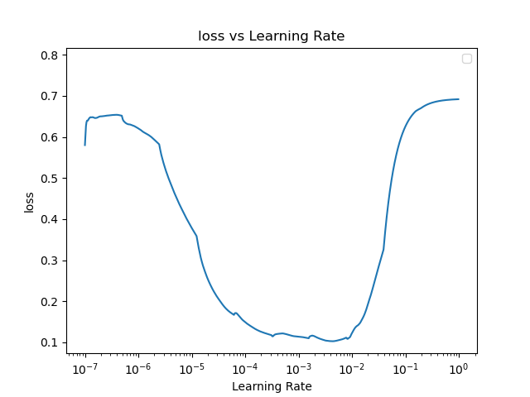
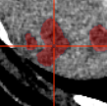
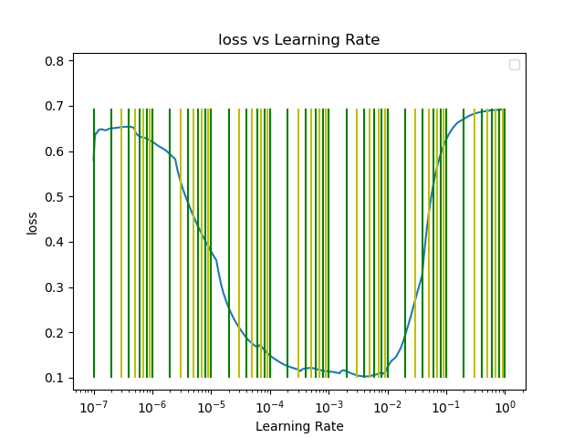
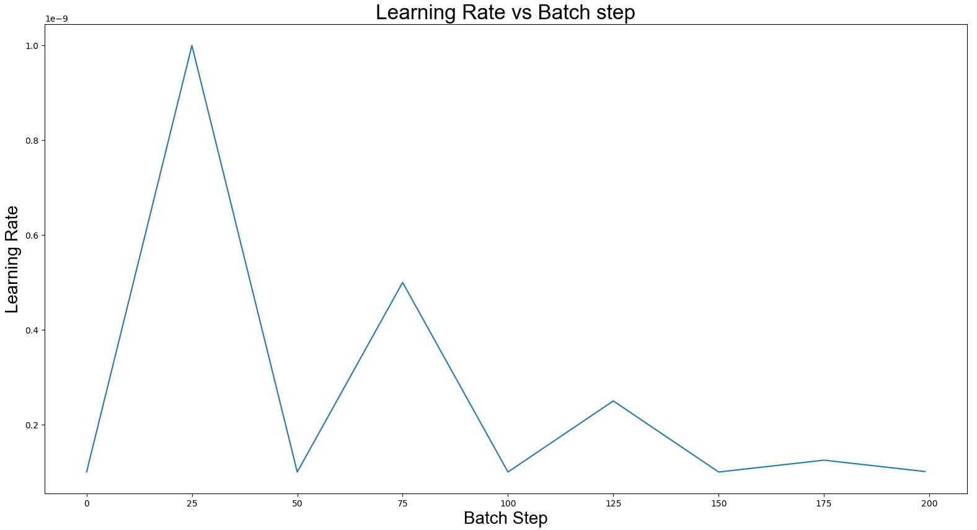
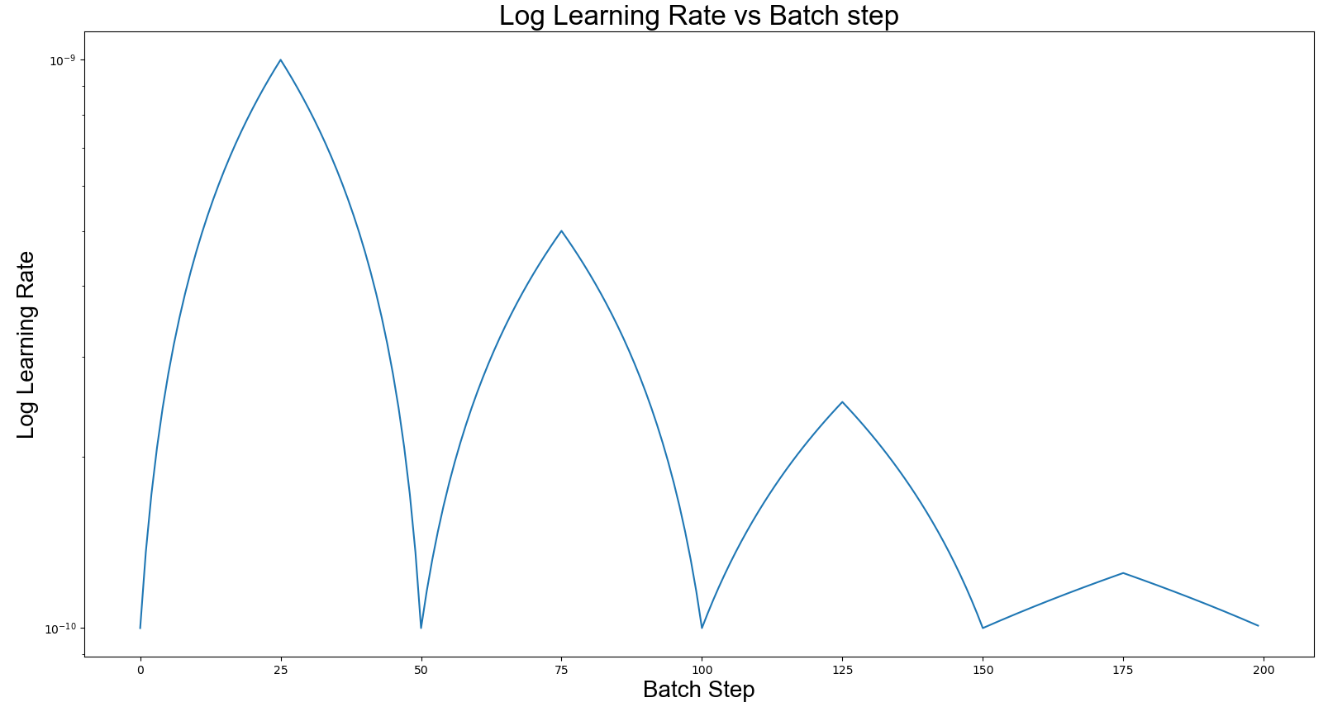
Min LR
Max LR
‘Vanilla’
Residual
Dense
64-d
64-d
Convolution
BN, Activation
Convolution
Convolution
Convolution
Concat
activation
activation
BN, Activation
Convolution
Convolution
Convolution
Concat
BN, Activation
activation
+
activation
Convolution
Concat

Slide 2
5
16
16
32
32
2
Layer 0
32
32
32
Layer 1
Concatenation
Transpose Conv
Strided Conv
64
64
Conv 3x3, ReLU
Layer 2
64
Conv 1x1, ReLU
64
64

Slide 3
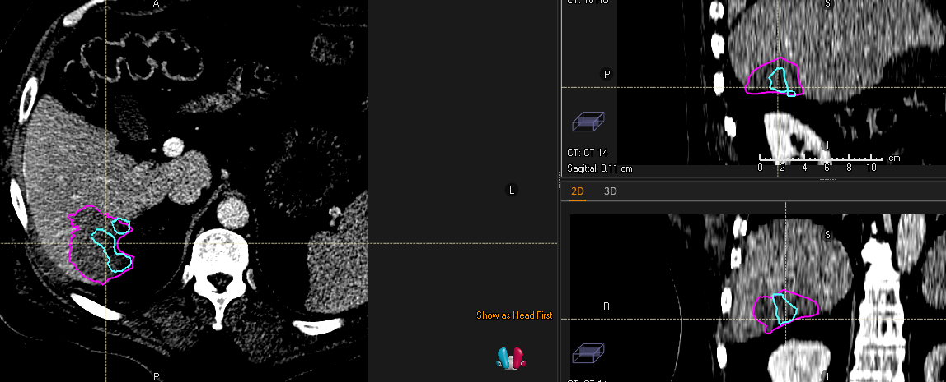
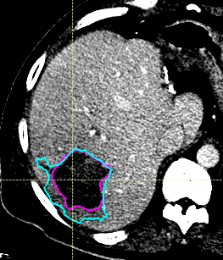
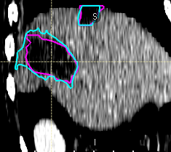
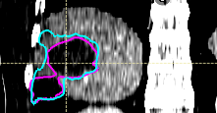
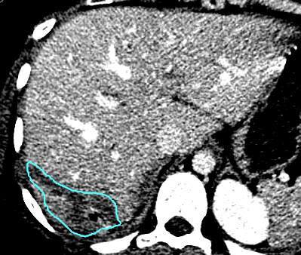
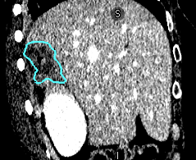
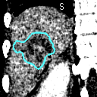

Slide 4
# of Convolution Blocks
3
16
16
32
32
2
Layer 0
A
32
32
32
Layer 1
Concat or Add
UpSampling + Conv
Strided Conv
64
64
Conv 3x3x3, ReLu
Layer 2
64
Conv 1x1x1, softmax
64
64
Standard
Residual
Dense
64-d
64-d
Convolution
BN, Activation
Convolution
Convolution
Convolution
B
activation
activation
BN, Activation
Concat
Convolution
Convolution
Convolution
BN, Activation
Concat
activation
+
Convolution
activation
Concat
Image
Elu + BN
Elu + BN
Elu + BN
Elu + BN
Elu + BN
Elu + BN
Elu + BN
Elu + BN
Softmax
Layer 0
Elu + BN
Elu + BN
Elu + BN
Elu + BN
Elu + BN
Bilinear Upsample,
Convolution 3x3x3
Layer 1
Strided Convolution 2x2x2
Convolution 3x3x3
Convolution 1x1x1
Concatenation

Slide 5
Image
Elu + BN
Elu + BN
Elu + BN
Elu + BN
Elu + BN
Elu + BN
Elu + BN
Elu + BN
Softmax
Layer 0
Elu + BN
Elu + BN
Elu + BN
Elu + BN
Elu + BN
Bilinear Upsample,
Convolution 3x3x3
Layer 1
Strided Convolution 2x2x2
Convolution 3x3x3
Convolution 1x1x1
Concatenation

Slide 6
 | 3D Unet |  |  | 2D DenseUNet-121 |  | Hybrid WNet
 | Standard | Residual | Dense | Encoder Frozen | All Trainable | 2D Frozen | All Trainable
Val Loss | 0.041 | 0.024 | 0.016 | 0.022 | 0.013 | 0.011 | 0.0092
Image
Image
Image
DenseNet 0
2D Features
Final Prediction
Softmax
Transition Block 1
Transition Block 2
Transition Block 3
Bilinear Upsample 2x2
Dense Block 4
Average Pooling 2x2
Add
Convolution 3x3, BN relu activation

Slide 7
2D Pre-Trained Feature Extractor
3D DenseNet
DenseNet 0
DenseNet 121
2D Features
Prediction
Image
Elu + BN
Elu + BN
2D Features
Elu + BN
Elu + BN
Elu + BN
Elu + BN
Elu + BN
Elu + BN
Elu + BN
Elu + BN
Softmax
b*16*128*128*3
Transition Block 1
Transition Block 2
Bilinear Upsample,
Convolution 3x3x3
Transition Block 3
Bilinear Upsample 2x2
Elu + BN
Elu + BN
Elu + BN
Elu + BN
Elu + BN
Strided Convolution 2x2x2
Average Pooling 2x2
Convolution 3x3x3
Dense Block 4
Add
Convolution 1x1x1
Convolution 3x3, BN relu activation
Concatenation
Convolution 3x3x3, BN relu activation

Slide 8
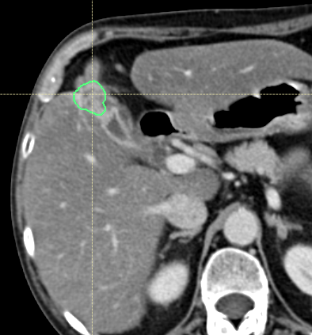
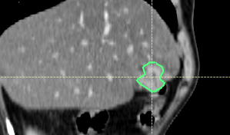
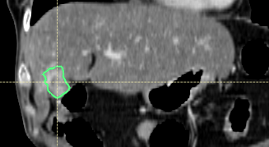
3DCIR 18

Slide 9
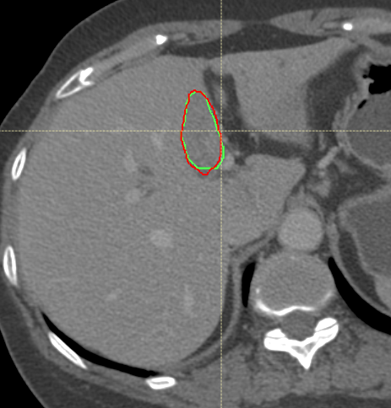
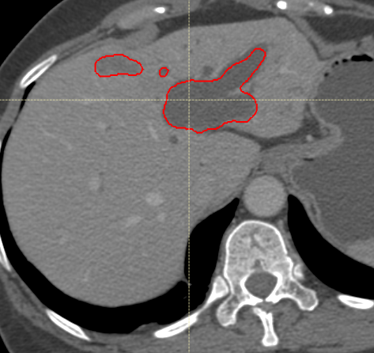
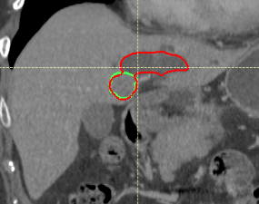
3DCIR 3

Slide 10
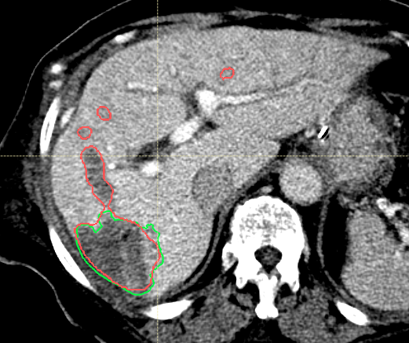
Quantitative Comparison of MDA

Slide 11
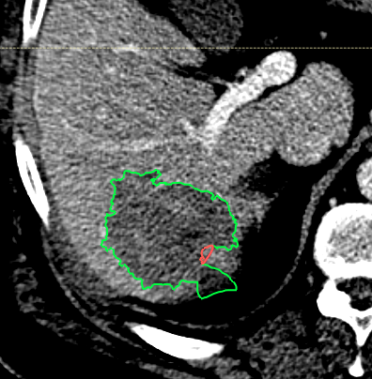
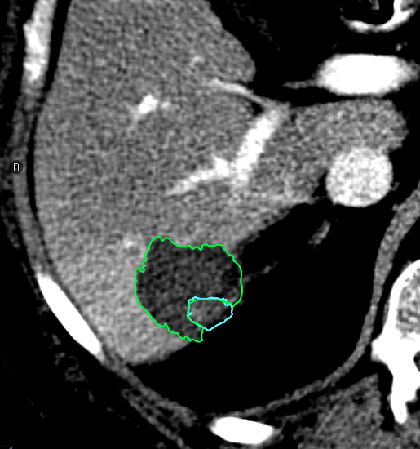
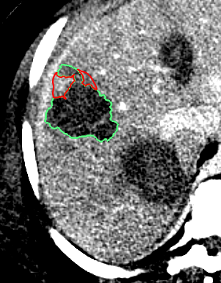
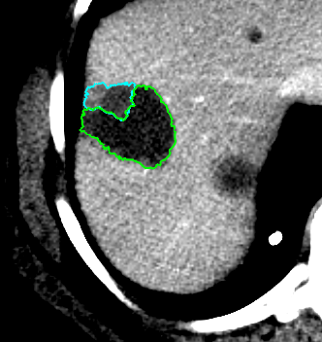
Patient 5
5 mm margin
Ablation
Recurrence
Ablation
Patient 14
5 mm margin
Ablation
Recurrence
Ablation

Slide 13
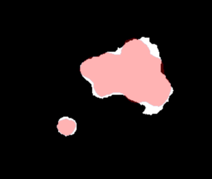
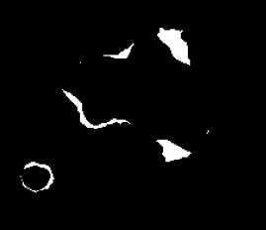
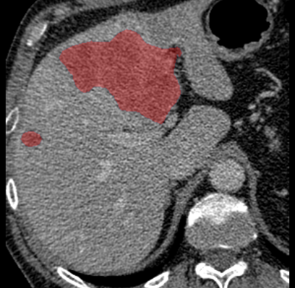
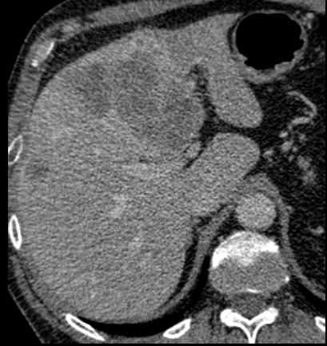
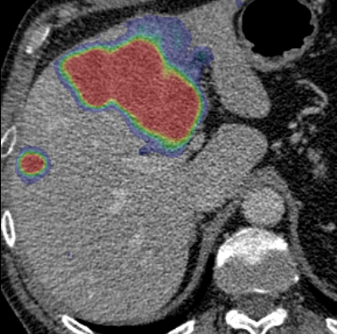
Lits_100
Ground Truth
Image
Prediction

Slide 14
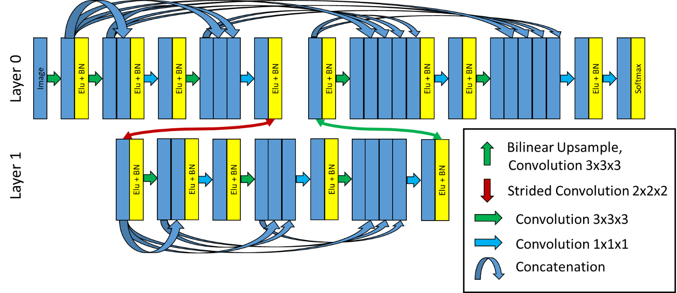
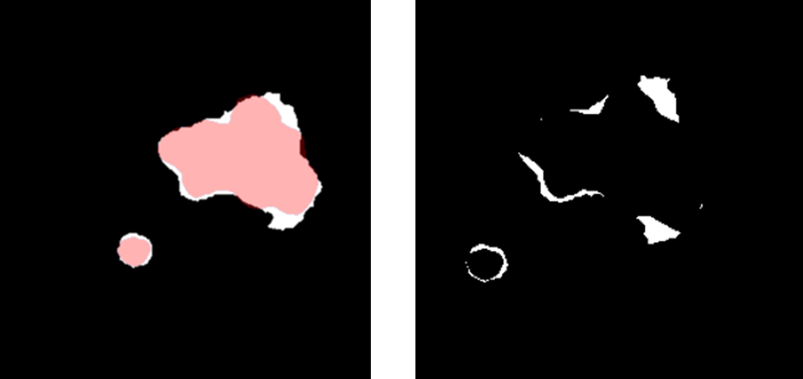
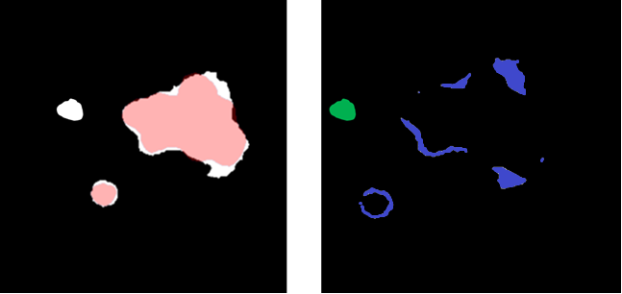

Slide 15
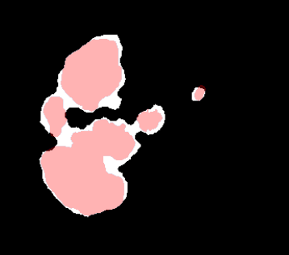
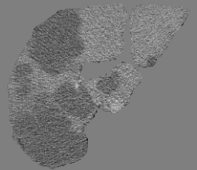

Slide 16
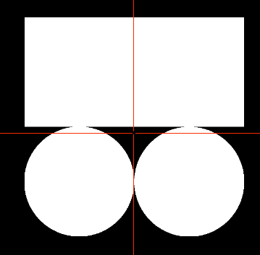
Lits 57 removed, not a patient
Lits 59 removed, not transverse
Lits 0

Slide 17
3
16
16
32
32
2
Layer 0
32
32
32
Layer 1
Concat or Add
UpSampling + Conv
Strided Conv
64
64
Conv 3x3x3, ReLu
Layer 2
64
Conv 1x1x1, softmax
64
64

